Slide 1
CAPSTONE PROJECT -Integrated Electrical Maintenance Equipment Analysis (2018-2021)
Business in Brief:

Slide 2
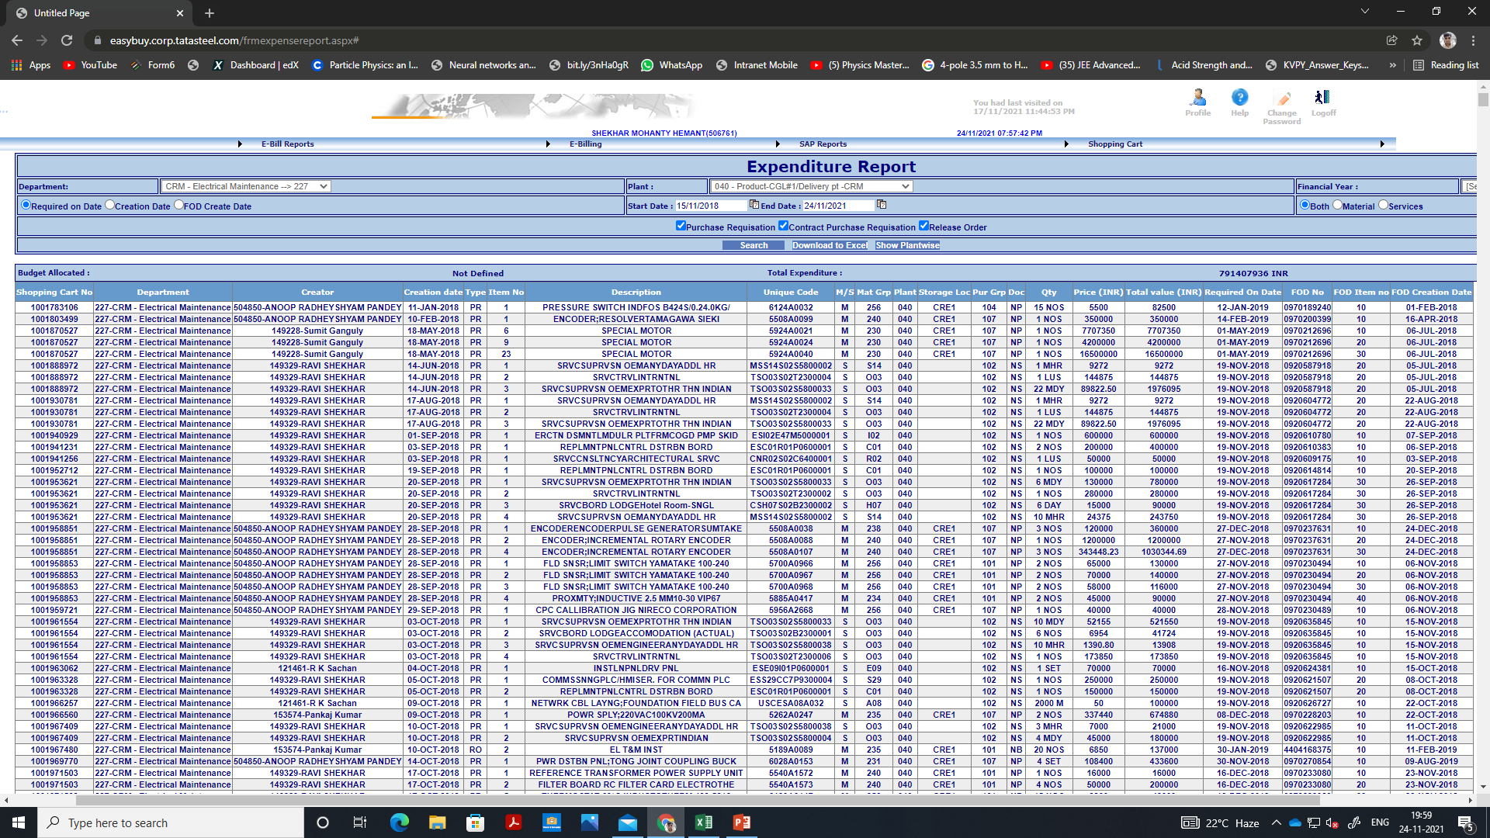
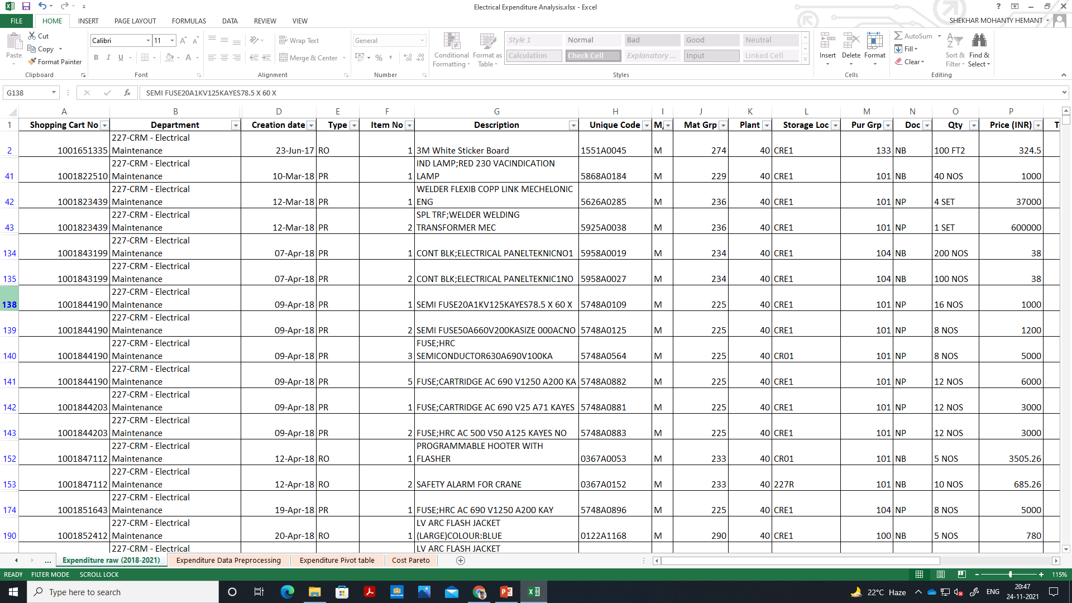
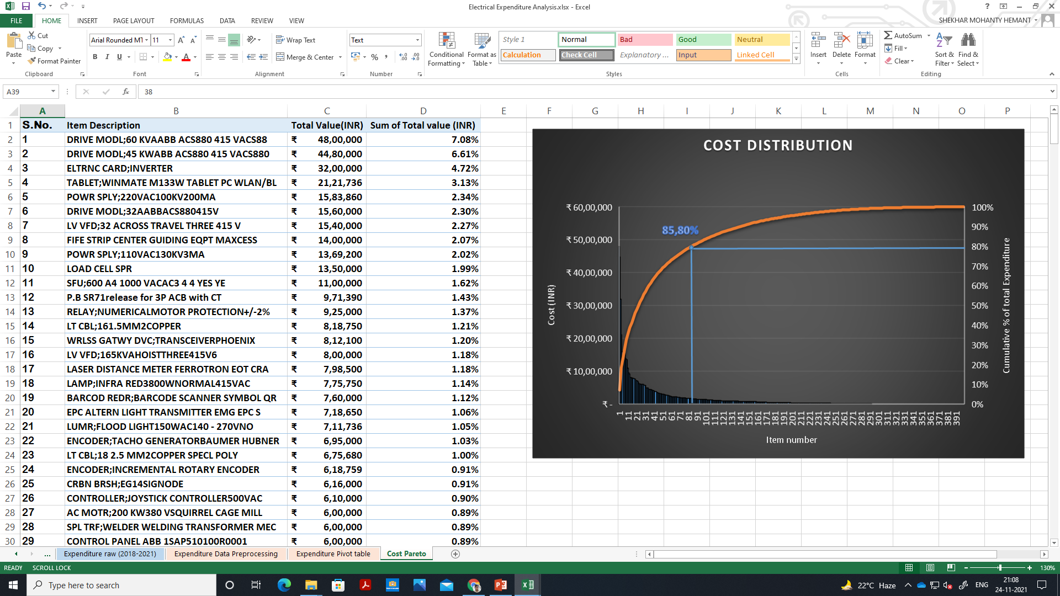
Data- Collection
RAW DATA FROM ERP SYSTEM
PRE-PROCESSING
CONSOLIDATED IN PIVOT TABLES
Raw data from ERP system of Expenditure on Electrical maintenance equipments over past 3 years of my department was exported in excel, pre-processing includes filtering raw data for my section(F&D) and deleting non electrical items.
I learned and used GitHub for working on my project from both home and office.

Slide 3
Analysis (Graphs and Charts) and interpretation

Slide 4
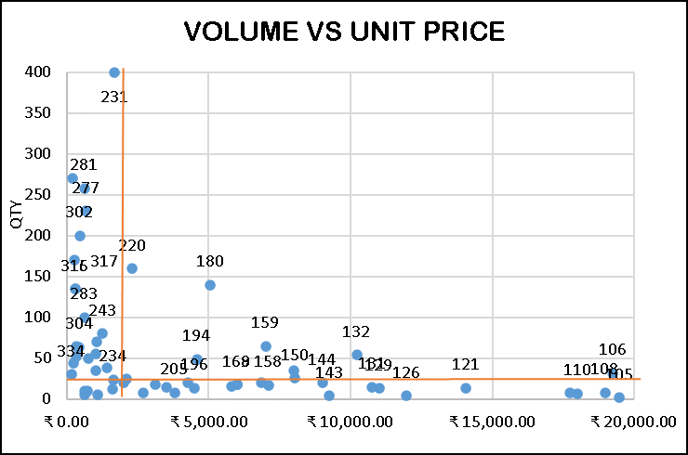
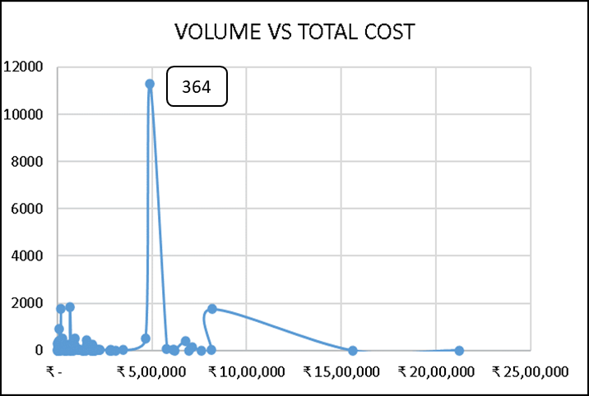
Analysis (Graphs and Charts) and interpretation

Slide 5
INSIGHTS AND RECOMMENDATIONs

